Slide 1
G2V LAB PROJECT
SHANI DANIEL

Slide 2
Recap of the work so far
Finding information about labels (functions) and labels relationships with each other, through the multi-labels each KO has. Including:
Inspecting labels in terms of “general” and “common” – we will say a label is more "common" if it appears in more KO's. we will say a label is more "general" if it appears with many different labels on average.
Getting information about pairs of labels - how many KO’s have both labels (aka how many times they appear in the same multi-label)
Looking for exceptional KO’s – KO’s with relatively many labels
Creating graphic visualization with labels as nodes and edges weights as the probability to see one label given the other. Inspecting central nodes and so.
Deriving conclusions based on the obtained results

Slide 3
Number of labels
519 labels appear overall in all multi- labels
516 labels appear in more than 1 KO
470 labels are left after filtering out labels that contain one of the following terms - "cancer", "disease", "carcinogenesis", "carcinoma", "GABAergic synapse", "helicobacter“ (and appear in more than 1 KO)
The relevant labels used as graph nodes and for other analysis are those 470 labels.

Slide 4
Interesting labels
Labels that appear in the largest number of KO’s (most common) – Transporters (1490 KO’s), Enzymes with EC numbers (1153), Chromosome and associated proteins (695), Membrane trafficking (645), Transcription factors (606)
Labels that appear with the highest number of different labels (most general) – Exosome (249 different labels), Membrane trafficking (175), Protein kinases (146), Peptidases and inhibitors (138), Chromosome and associated proteins (130)

Slide 5
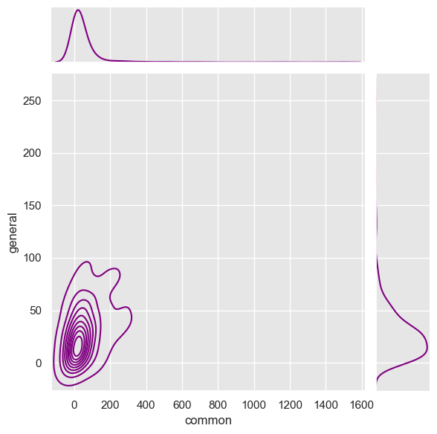
Common vs general labels
We can see that most labels are not so common and not so general (next slide shows more information about exceptions)
It should be mentioned that the “general” graph has 2 picks before filtering the words we mentioned at slide #3 – 1 major pick as shown, and another pick at around 150, that disappears after filtering the data

Slide 6
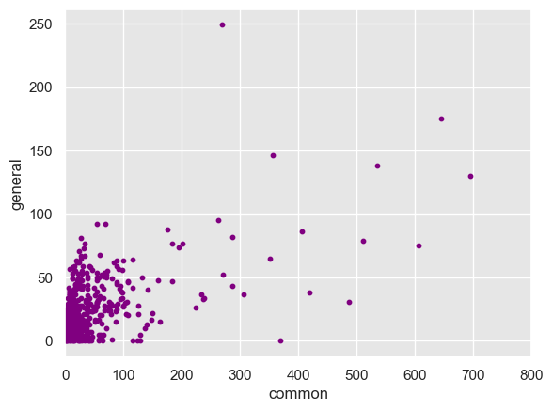
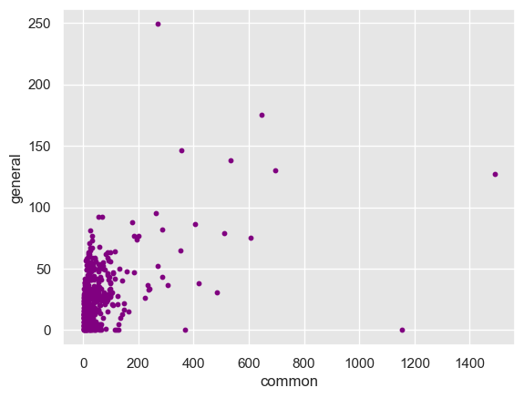
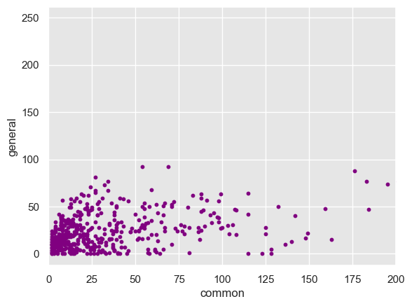
X axis limited
Exosome
Transporters
Enzymes with EC number

Slide 7
Analyzing pairs of labels
We created a matrix, that holds at cell i,j the number of unique KO's that has the labels i and j together (i.e. in the same multi_label)
Dictionary for translating labels to index number used in the matrix can be found in appendix
Diagonal (i,i cells) is zeros
We normalized the matrix by z-score normalization. The result is in the next slide.
We created the same matrix using only the labels that appear in more than the average number of unique KO’s for label(53.73). It reduced the number of labels to 120. The result is in slide #9. Translation in appendix.

Slide 8
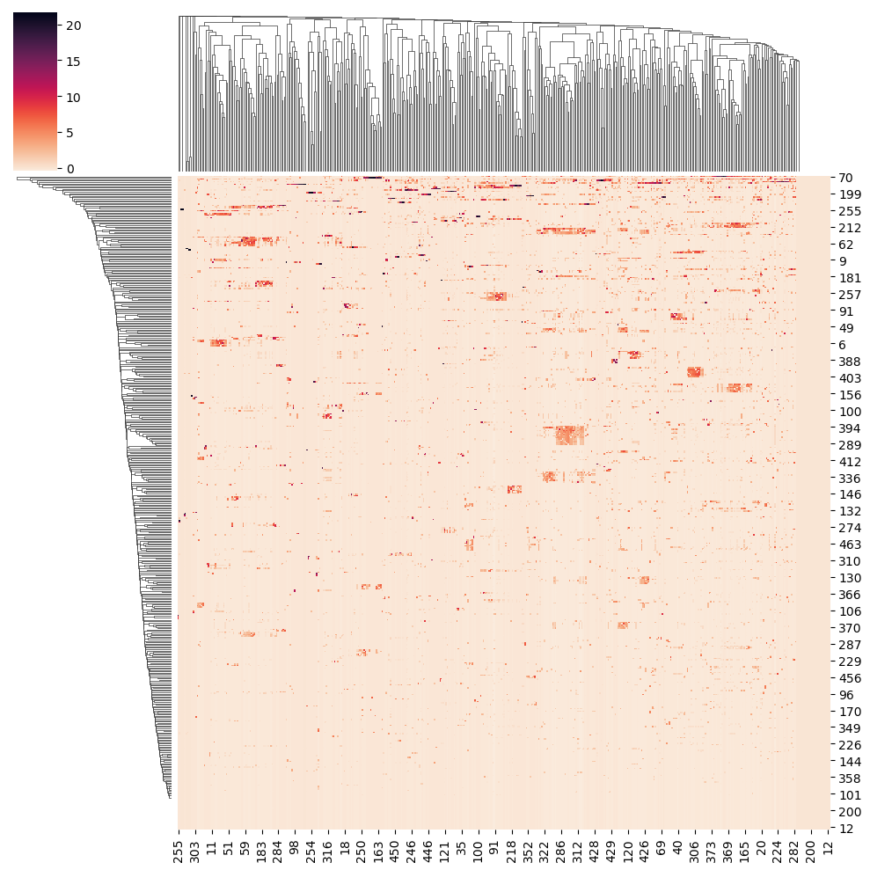
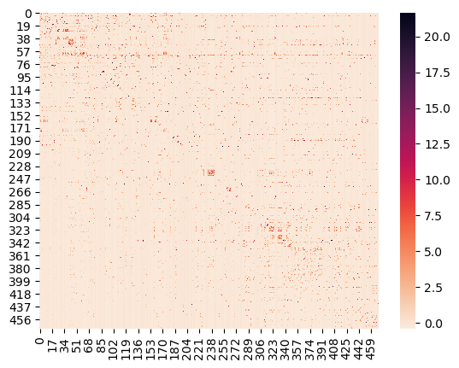
Matrix & clutermap view

Slide 9
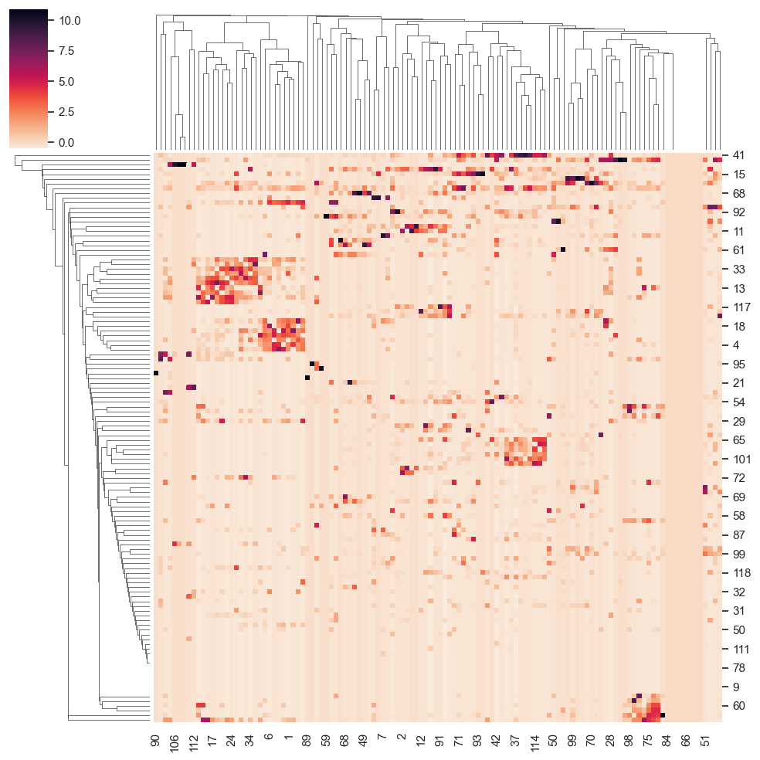
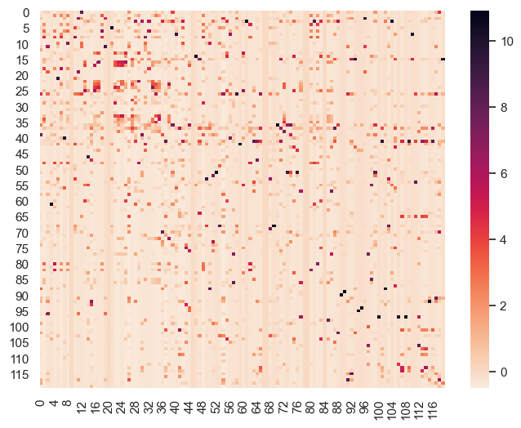
Matrix & clutermap (ABOVE AVG)

Slide 10
INTRESTING OBSERVESIONS
The pair that appears together in most KO’s is Transporters and ABC Transporters, with the value of 485.
The median of the matrix (zeros excluded – else 0) is 1 (unnormalized).
The 0.99 quantile is 4 (unnormalized). Hence pairs of labels that appear together (in the same KO) more than 4 times constitute the 1% labels that come together the most in this measure. These pairs are identified in the appendix.
Transporters also appears to come relatively many times (more than the 0.99 quantile) with relatively many labels, including – Exosome, secretion system, membrane trafficking, etc (more examples appear in appendix)

Slide 11
Number of labels per ko
The average number of labels a KO has in our data is 1.65 labels. The median is 1 label.
The minimum is 1 label and the maximum is 19 labels.
It should be mentioned that before filtering our data, the maximum number was 123(!). most KO’s found with exceptionally many labels had labels connected to hormones secretion, signaling pathways and cancer, hence filtered in our filtration.
The KO’s with most labels after the filtration, also mostly contain labels connected to hormones secretion and signaling pathways .

Slide 12
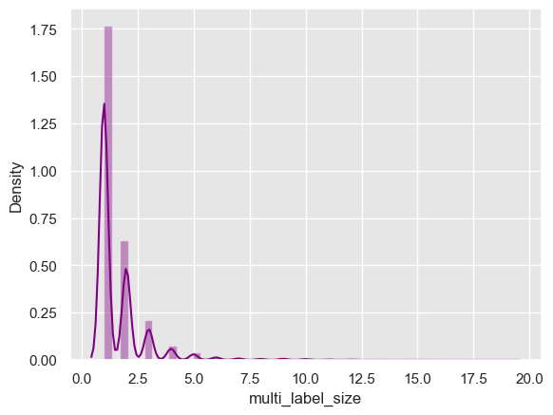
Num of labels per ko chart

Slide 13
Graphic visualization & Inspection
We built a directed graph where nodes are labels, and there is an edge from f1 to f2 with weight = P(f2|f1). Meaning, the fraction of KO’s that has both labels, from the number of KO’s that have f1 as label (in multi – label).
In the next slide, the graphic visualization shows only edges with weight over 0.2 (meaning - more than 20% of f1 appearances are with f2).
The nodes used for the graph in the next slide are only the labels that appear in more than average KO’s, in order to reduce the number of nodes to the more relevant ones and improve the graphs readability.
Conclusions about nodes centrality – hence “popularity” in appearing with other nodes, appear in the next slides.

Slide 14
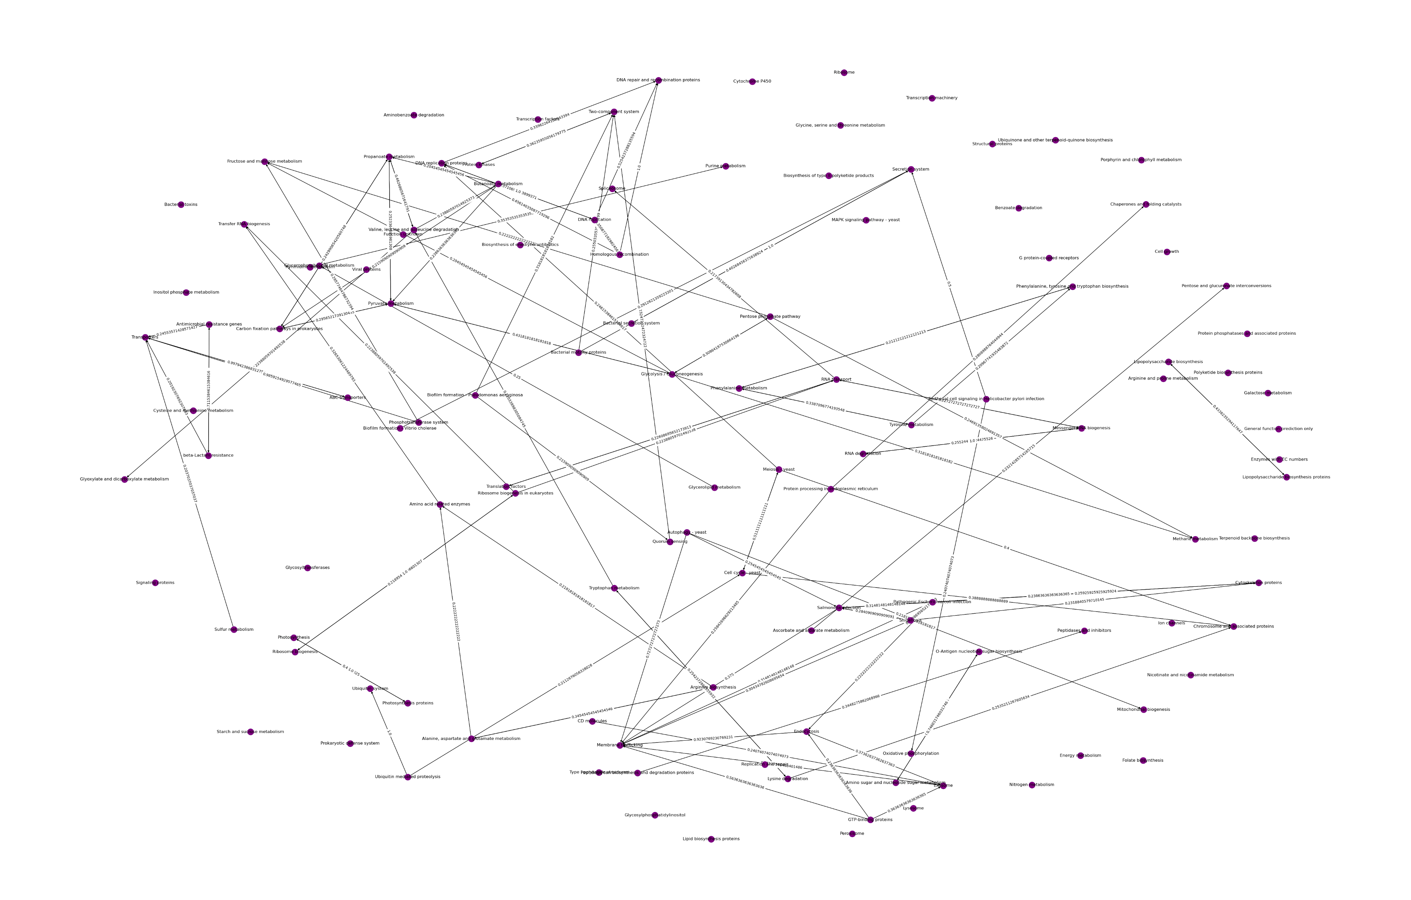

Slide 15
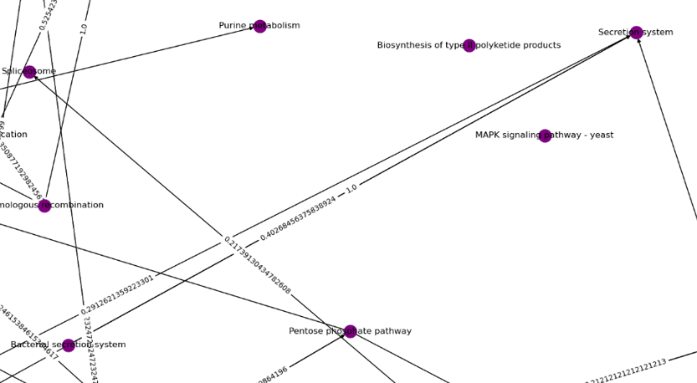
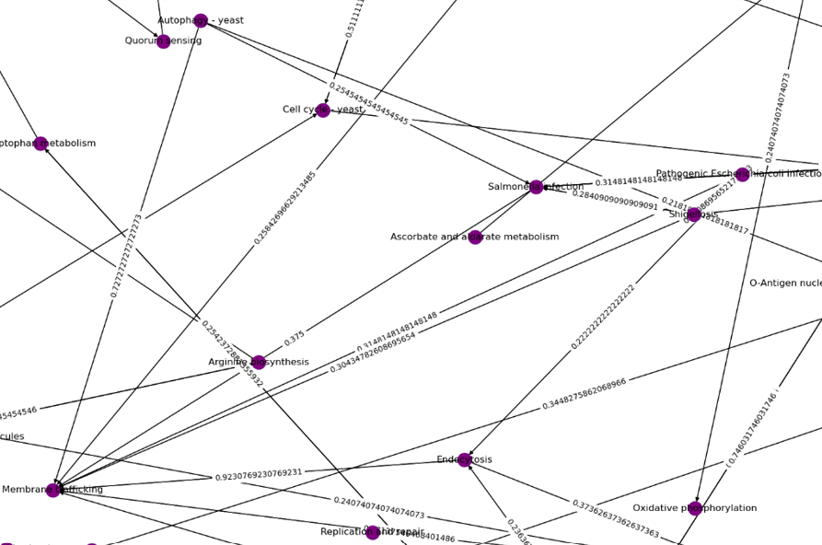
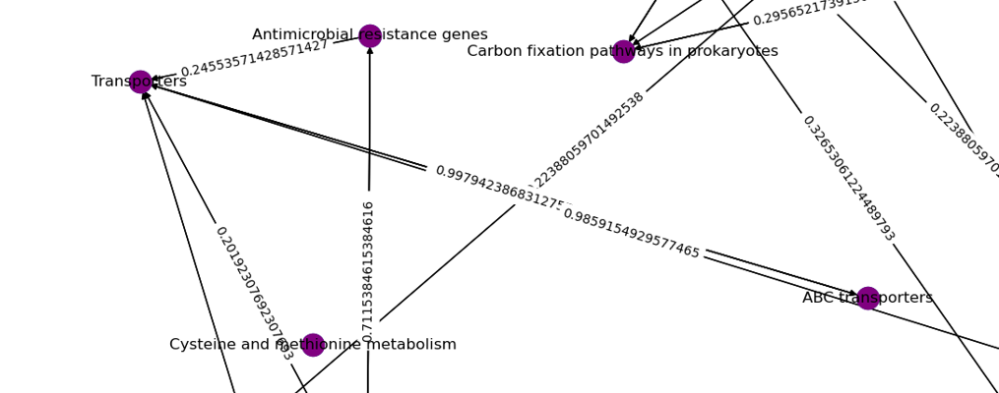
OBSERVATIONS
All the KO’s that include the label Bacterial secretion system, also include the label Secretion system
Membrane trafficking seems to have a large in-degree, meaning relatively many labels tend to usually come with membrane trafficking
99.7% of the KO’s that include the label ABC Transporters, also include the label Transporters (edge: ABC Transporters -> Transporters)

Slide 16
Further analysis of the graph
In order to further analyze the graph, we created a table which inspects each node by multiple parameters – in degree, out degree, sum in /out weights, etc.
We also included 3 centrality measurements –
in degree centrality - the fraction of nodes that has an edge to the measured node, from all nodes in the graph
out degree centrality - the fraction of nodes that the measured node has an edge to, from all nodes in the graph
eigenvector centrality - computes the centrality for a node based on the centrality of its neighbors. The eigenvector centrality for node i is the i-th element of the vector x defined by the equation Ax = cx
Part of the table is presented in the next slide. The table was sorted by descending eigenvector centrality values.

Slide 17
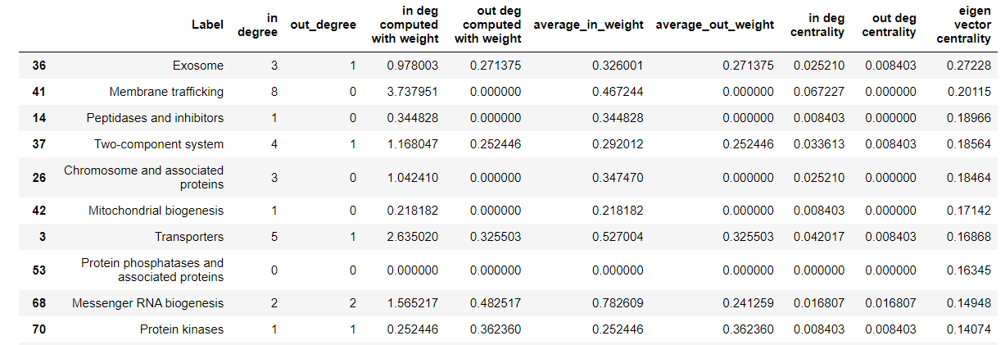
TOP 10 ROWS IN the TABLE

Slide 18
Conclusions from analysis
Membrane trafficking has the highest in degree (8), also with respect to edges weights. It suggests that this label is central and could maybe replace some of the labels directed at it, especially the ones with higher weight.
The observation between Transporters and ABC transporters could suggest that ABC transporters can be ignored/ replaced with Transporters.
The same deduction can be made for Secretion system and Bacterial secretion system. We can keep observing and find more similar connections.
Transporters also has a relatively high in – degree, also in respect to weights, which could suggest more labels that can be “combined with it”.
Exosome got the highest eigen vector centrality score, and from looking at the graph we can see it has an out – edge to membrane trafficking. It probably what enhanced its centrality, and we could also consider the connection between these 2 labels and the labels going into Exosome, as they maybe could also be “combined”.

Slide 19
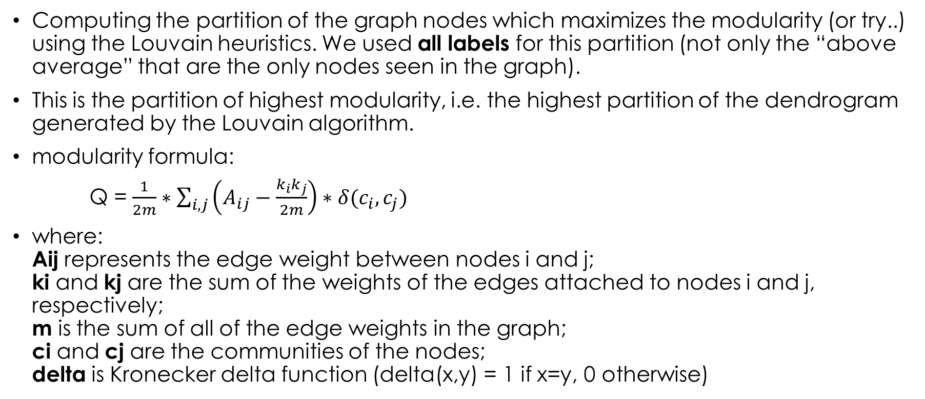
Louvain community detection
Computing the partition of the graph nodes which maximizes the modularity (or try..) using the Louvain heuristics. We used all labels for this partition (not only the “above average” that are the only nodes seen in the graph).
This is the partition of highest modularity, i.e. the highest partition of the dendrogram generated by the Louvain algorithm.
modularity formula:
Q = $\frac{1}{2m}∗\sum_{i,j}{\left(A_{ij}−\frac{k_{i}k_{j}}{2m}\right)∗δ(c_{i}, c_{j})}$
where: Aij represents the edge weight between nodes i and j; ki and kj are the sum of the weights of the edges attached to nodes i and j, respectively; m is the sum of all of the edge weights in the graph; ci and cj are the communities of the nodes; delta is Kronecker delta function (delta(x,y) = 1 if x=y, 0 otherwise)

Slide 20
Partition (with resolution = 0.2)
{'MAPK signaling pathway - yeast', 'Prokaryotic defense system', 'Transcription factors’}
{'Tyrosine metabolism', 'Phenylalanine metabolism', 'Amino acid related enzymes', 'Alanine, aspartate and glutamate metabolism', 'Phenylalanine, tyrosine and tryptophan biosynthesis', 'Arginine and proline metabolism', 'Arginine biosynthesis', 'Ubiquinone and other terpenoid-quinone biosynthesis', 'Nitrogen metabolism', 'Cysteine and methionine metabolism’}
{'DNA replication', 'Homologous recombination', 'DNA repair and recombination proteins', 'DNA replication proteins’}
{'Phosphotransferase system', 'Sulfur metabolism', 'Transporters', 'ABC transporters’}
{'Ribosome biogenesis in eukaryotes', 'Translation factors', 'Ribosome biogenesis', 'Transfer RNA biogenesis', 'RNA transport', 'Mitochondrial biogenesis', 'Ribosome’}
{'Nicotinate and nicotinamide metabolism', 'Glycosylphosphatidylinositol', 'Starch and sucrose metabolism', 'Purine metabolism', 'Viral proteins', 'Pyrimidine metabolism', 'Glycosyltransferases’}
{'Methane metabolism', 'Pentose phosphate pathway', 'Carbon fixation pathways in prokaryotes', 'Pyruvate metabolism', 'Glycolysis / Gluconeogenesis’}
{'Fructose and mannose metabolism', 'Ascorbate and aldarate metabolism', 'Amino sugar and nucleotide sugar metabolism', 'Galactose metabolism', 'Porphyrin and chlorophyll metabolism', 'Pentose and glucuronate interconversions', 'O-Antigen nucleotide sugar biosynthesis’}
{'Peptidoglycan biosynthesis and degradation proteins', 'Peptidases and inhibitors', 'G protein-coupled receptors’}
{'Valine, leucine and isoleucine degradation', 'Propanoate metabolism', 'Peroxisome', 'Glycine, serine and threonine metabolism', 'Terpenoid backbone biosynthesis', 'Glyoxylate and dicarboxylate metabolism’}

Slide 21
continued
{'Butanoate metabolism', 'Lysine degradation', 'Tryptophan metabolism', 'Aminobenzoate degradation', 'Benzoate degradation’}
{'Cell cycle - yeast', 'Transcription machinery', 'Meiosis - yeast', 'Chromosome and associated proteins’}
{'Inositol phosphate metabolism', 'Ion channels', 'Bacterial toxins', 'Protein phosphatases and associated proteins’}
{'Two-component system', 'Protein kinases', 'Biofilm formation - Pseudomonas aeruginosa', 'Quorum sensing’}
{'CD molecules', 'Lysosome', 'Exosome’}
{'GTP-binding proteins', 'Endocytosis', 'Membrane trafficking', 'Autophagy - yeast’}
{'Photosynthesis', 'Photosynthesis proteins', 'Oxidative phosphorylation’}
{'Protein processing in endoplasmic reticulum', 'Chaperones and folding catalysts’}
{'beta-Lactam resistance', 'Folate biosynthesis', 'Antimicrobial resistance genes’}
{'Biofilm formation - Vibrio cholerae', 'Bacterial motility proteins', 'Epithelial cell signaling in Helicobacter pylori infection', 'Secretion system', 'Bacterial secretion system’}
{'Glycerophospholipid metabolism', 'Biosynthesis of type II polyketide products', 'Biosynthesis of enediyne antibiotics', 'Type I polyketide structures', 'Glycerolipid metabolism', 'Lipid biosynthesis proteins', 'Polyketide biosynthesis proteins', 'Cytochrome P450’}
{'Pathogenic Escherichia coli infection', 'Shigellosis', 'Cytoskeleton proteins', 'Salmonella infection’}
{'Spliceosome', 'RNA degradation', 'Messenger RNA biogenesis’}
{'Lipopolysaccharide biosynthesis proteins', 'Lipopolysaccharide biosynthesis’}
{'Ubiquitin mediated proteolysis', 'Ubiquitin system'}

Slide 22
Labels in their own group
{'Function unknown’}
{'Enzymes with EC numbers’}
{'Signaling proteins’}
{'Energy metabolism’}
{'Cell growth’}
{'Structural proteins’}
{'Replication and repair’}
{'General function prediction only’}

Slide 23
Opinions & some deduction
The partition seems logical but a bit off. Higher resolution would produce less groups and “combine” more groups together. This seems like a fair resolution, but still some large groups seem too general. Maybe a different partition algorithm should be considered, or we can try to take the partition we got and add some prior knowledge to it to create a better manual partition (0.5 resolution partition – in appendix).
It should be mentioned that this partition was made only on the 120 “above average” labels. We can use the same algorithm to partition all the labels, but we should except mainly more smaller groups or labels in their own group.
It should also be mentioned that the Louvain detection algorithm available in python demands an undirected graph. Thus to preform this algorithm we created an equivalent undirected graph with weight arbitrary chosen between the 2 weights when there are edges for both ways between 2 nodes. It also could have an impact on the result.

Slide 24
Appendix

Slide 25
{'Transcription factors': 0, 'Arginine and proline metabolism': 1, 'Valine, leucine and isoleucine biosynthesis': 2, 'Pantothenate and CoA biosynthesis': 3, 'DNA repair and recombination proteins': 4, 'Transporters': 5, 'Phenylalanine, tyrosine and tryptophan biosynthesis': 6, 'Ribosome biogenesis': 7, 'Pyrimidine metabolism': 8, 'Alanine, aspartate and glutamate metabolism': 9, 'Mismatch repair': 10, 'Amino acid related enzymes': 11, 'Enzymes with EC numbers': 12, 'Transfer RNA biogenesis': 13, 'DNA replication proteins': 14, 'Prokaryotic defense system': 15, 'Methane metabolism': 16, 'Streptomycin biosynthesis': 17, 'Polyketide sugar unit biosynthesis': 18, 'Acarbose and validamycin biosynthesis': 19, 'Peptidases and inhibitors': 20, 'Diabetic cardiomyopathy': 21, 'Amino sugar and nucleotide sugar metabolism': 22, 'Insulin resistance': 23, 'Aminoacyl-tRNA biosynthesis': 24, 'Carbon fixation pathways in prokaryotes': 25, 'Citrate cycle': 26, 'Pyruvate metabolism': 27, 'Arginine biosynthesis': 28, 'DNA replication': 29, 'Function unknown': 30, 'Ribosome biogenesis in eukaryotes': 31, 'Histidine metabolism': 32, 'Glyoxylate and dicarboxylate metabolism': 33, 'Carbapenem biosynthesis': 34, 'Sulfur relay system': 35, 'Butanoate metabolism': 36, 'Glycolysis / Gluconeogenesis': 37, 'Nitrotoluene degradation': 38, 'Propanoate metabolism': 39, 'PI3K-Akt signaling pathway': 40, 'Adipocytokine signaling pathway': 41, 'Glucagon signaling pathway': 42, 'FoxO signaling pathway': 43, 'PPAR signaling pathway': 44, 'AMPK signaling pathway': 45, 'Insulin signaling pathway': 46, 'Proximal tubule bicarbonate reclamation': 47, 'Chromosome and associated proteins': 48, 'Terpenoid backbone biosynthesis': 49, 'Peroxisome': 50, 'Vitamin B6 metabolism': 51, 'Glycine, serine and threonine metabolism': 52, 'Bacterial toxins': 53, 'Porphyrin and chlorophyll metabolism': 54, 'Nitrogen metabolism': 55, 'Chloroalkane and chloroalkene degradation': 56, 'Synthesis and degradation of ketone bodies': 57, 'Fat digestion and absorption': 58, 'Lysine degradation': 59, 'Valine, leucine and isoleucine degradation': 60, 'Tryptophan metabolism': 61, 'Fatty acid degradation': 62, 'Exosome': 63, 'Two-component system': 64, 'Benzoate degradation': 65, 'Lysine biosynthesis': 66, 'Quorum sensing': 67, 'Purine metabolism': 68, 'MAPK signaling pathway - plant': 69, 'Membrane trafficking': 70, 'Drug metabolism - other enzymes': 71, 'Selenocompound metabolism': 72, 'Carbohydrate metabolism': 73, 'Mitochondrial biogenesis': 74, 'Glycosyltransferases': 75, 'Oxidative phosphorylation': 76, 'General function prediction only': 77, 'O-Antigen nucleotide sugar biosynthesis': 78, 'Longevity regulating pathway - multiple species': 79, 'Chaperones and folding catalysts': 80, 'Cysteine and methionine metabolism': 81, 'Prenyltransferases': 82, 'Peptidoglycan biosynthesis': 83, 'Translation factors': 84, 'Folate biosynthesis': 85, 'Cofactor metabolism': 86, 'Secretion system': 87, 'Bacterial secretion system': 88, 'Protein export': 89, 'Transcription': 90, 'Protein phosphatases and associated proteins': 91, 'RNA transport': 92, 'Proteasome': 93, 'Fructose and mannose metabolism': 94, 'Nicotinate and nicotinamide metabolism': 95, 'Taurine and hypotaurine metabolism': 96, 'Glycerophospholipid metabolism': 97, 'Sesquiterpenoid and triterpenoid biosynthesis': 98, 'Transcription machinery': 99, 'RNA polymerase': 100, 'Ribosome': 101, 'Antifolate resistance': 102, 'One carbon pool by folate': 103, 'Pentose phosphate pathway': 104, 'ABC transporters': 105, 'Riboflavin metabolism': 106, 'Ubiquinone and other terpenoid-quinone biosynthesis': 107, 'Phosphatidylinositol signaling system': 108, 'Inositol phosphate metabolism': 109, 'Cyanoamino acid metabolism': 110, 'Protein processing in endoplasmic reticulum': 111, 'Phagosome': 112, 'Vibrio cholerae infection': 113, 'Cell cycle - Caulobacter': 114, 'Cytoskeleton proteins': 115, 'Others': 116, 'Structural proteins': 117, 'Replication and repair': 118, 'Monobactam biosynthesis': 119, 'HIF-1 signaling pathway': 120, 'Messenger RNA biogenesis': 121, 'RNA degradation': 122, 'Biosynthesis of various secondary metabolites - part 2': 123, 'Phosphonate and phosphinate metabolism': 124, 'Glucosinolate biosynthesis': 125, 'C5-Branched dibasic acid metabolism': 126, 'Protein kinases': 127, 'Rheumatoid arthritis': 128, 'Toll-like receptor signaling pathway': 129, 'Osteoclast differentiation': 130, 'Lysosome': 131, 'Apoptosis': 132, 'Phenylpropanoid biosynthesis': 133, 'Aminobenzoate degradation': 134, 'Bacterial motility proteins': 135, 'Retinol metabolism': 136, 'Tuberculosis': 137, 'Biofilm formation - Pseudomonas aeruginosa': 138, 'Starch and sucrose metabolism': 139, 'Basal transcription factors': 140, 'Nucleotide excision repair': 141, 'Transport': 142, 'Epithelial cell signaling in Helicobacter pylori infection': 143, 'Steroid degradation': 144, 'Non-homologous end-joining': 145, 'Base excision repair': 146, 'Lipid biosynthesis proteins': 147, 'Dorso-ventral axis formation': 148, 'Signaling proteins': 149, 'Energy metabolism': 150, 'Staphylococcus aureus infection': 151, 'Bacterial chemotaxis': 152, 'Other glycan degradation': 153, 'Phenylalanine metabolism': 154, 'Novobiocin biosynthesis': 155, 'N-Glycan biosynthesis': 156, 'Thiamine metabolism': 157, 'Sulfur metabolism': 158, 'Oxytocin signaling pathway': 159, 'Isoquinoline alkaloid biosynthesis': 160, 'Tropane, piperidine and pyridine alkaloid biosynthesis': 161, 'Tyrosine metabolism': 162, 'Other types of O-glycan biosynthesis': 163, 'Galactose metabolism': 164, 'Amoebiasis': 165, 'Bacterial invasion of epithelial cells': 166, 'Yersinia infection': 167, 'Longevity regulating pathway - worm': 168, 'Cell growth': 169, 'Lipoarabinomannan': 170, 'Parathyroid hormone synthesis, secretion and action': 171, 'Limonene and pinene degradation': 172, 'Ascorbate and aldarate metabolism': 173, 'Glycerolipid metabolism': 174, 'Insect hormone biosynthesis': 175, 'beta-Alanine metabolism': 176, 'Biotin metabolism': 177, 'Fatty acid biosynthesis': 178, 'Flagellar assembly': 179, 'Protein processing': 180, 'Protein digestion and absorption': 181, 'CD molecules': 182, 'Carbon fixation in photosynthetic organisms': 183, 'Antimicrobial resistance genes': 184, 'Lipopolysaccharide biosynthesis': 185, 'Lipopolysaccharide biosynthesis proteins': 186, 'Glycan metabolism': 187, 'Meiosis - yeast': 188, 'Neurotrophin signaling pathway': 189, 'Ubiquitin system': 190, 'Vancomycin resistance': 191, 'D-Alanine metabolism': 192, 'Peptidoglycan biosynthesis and degradation proteins': 193, 'Glutathione metabolism': 194, 'Photosynthesis proteins': 195, 'Photosynthesis': 196, 'Homologous recombination': 197, 'Fanconi anemia pathway': 198, 'Polyketide biosynthesis proteins': 199, 'Lipoic acid metabolism': 200, 'Biosynthesis of various secondary metabolites - part 3': 201, 'mRNA surveillance pathway': 202, 'Pentose and glucuronate interconversions': 203, 'Biosynthesis of vancomycin group antibiotics': 204, 'Arabinogalactan biosynthesis - Mycobacterium': 205, 'Cell motility': 206, 'Necroptosis': 207, 'D-Glutamine and D-glutamate metabolism': 208, 'Biofilm formation - Vibrio cholerae': 209, 'Secondary metabolism': 210, 'Biosynthesis of type II polyketide products': 211, 'Endocytosis': 212, 'Prodigiosin biosynthesis': 213, 'Penicillin and cephalosporin biosynthesis': 214, 'beta-Lactam resistance': 215, 'Phenazine biosynthesis': 216, 'Mineral absorption': 217, 'Platinum drug resistance': 218, 'Apoptosis - fly': 219, 'Photosynthesis - antenna proteins': 220, 'Carotenoid biosynthesis': 221, 'Cationic antimicrobial peptide': 222, 'Mannose type O-glycan biosynthesis': 223, 'African trypanosomiasis': 224, 'Fluid shear stress and atherosclerosis': 225, 'Spinocerebellar ataxia': 226, 'Atrazine degradation': 227, 'Leishmaniasis': 228, 'Legionellosis': 229, 'Neomycin, kanamycin and gentamicin biosynthesis': 230, 'Furfural degradation': 231, 'Amino acid metabolism': 232, 'Hematopoietic cell lineage': 233, 'Cell adhesion molecules': 234, 'Human papillomavirus infection': 235, 'Arrhythmogenic right ventricular cardiomyopathy': 236, 'Regulation of actin cytoskeleton': 237, 'Hypertrophic cardiomyopathy': 238, 'ECM-receptor interaction': 239, 'Dilated cardiomyopathy': 240, 'Leukocyte transendothelial migration': 241, 'Focal adhesion': 242, 'Translation': 243, 'Steroid biosynthesis': 244, 'Spliceosome': 245, 'Biofilm formation - Escherichia coli': 246, 'Phosphotransferase system': 247, 'Sphingolipid metabolism': 248, 'Glycosphingolipid biosynthesis - globo and isoglobo series': 249, 'Glycosaminoglycan degradation': 250, 'Ferroptosis': 251, 'Thermogenesis': 252, 'Biosynthesis of unsaturated fatty acids': 253, 'Biosynthesis of siderophore group nonribosomal peptides': 254, 'Unclassified viral proteins': 255, 'Glycosylphosphatidylinositol': 256, 'Human T-cell leukemia virus 1 infection': 257, 'Cholesterol metabolism': 258, 'Neuroactive ligand-receptor interaction': 259, 'Dioxin degradation': 260, 'Xylene degradation': 261, 'Type I polyketide structures': 262, 'Chlorocyclohexane and chlorobenzene degradation': 263, 'Fluorobenzoate degradation': 264, 'Toluene degradation': 265, 'Pertussis': 266, 'Plant-pathogen interaction': 267, 'Pathogenic Escherichia coli infection': 268, 'Zeatin biosynthesis': 269, 'Various types of N-glycan biosynthesis': 270, 'Glycosphingolipid biosynthesis - ganglio series': 271, 'Secondary bile acid biosynthesis': 272, 'Naphthalene degradation': 273, 'Polycyclic aromatic hydrocarbon degradation': 274, 'Biosynthesis of enediyne antibiotics': 275, 'Primary immunodeficiency': 276, 'Caprolactam degradation': 277, 'Adherens junction': 278, 'O-Antigen repeat unit biosynthesis': 279, 'Nucleotide metabolism': 280, 'Lipid and atherosclerosis': 281, 'Type I diabetes mellitus': 282, 'Prolactin signaling pathway': 283, 'Styrene degradation': 284, 'Domain-containing proteins not elsewhere classified': 285, 'Thyroid hormone synthesis': 286, 'B cell receptor signaling pathway': 287, 'Lectins': 288, 'Carbohydrate digestion and absorption': 289, 'Pancreatic secretion': 290, 'Salivary secretion': 291, 'Autophagy - yeast': 292, 'Viral proteins': 293, 'Metabolism of xenobiotics by cytochrome P450': 294, 'Drug metabolism - cytochrome P450': 295, 'NOD-like receptor signaling pathway': 296, 'Biosynthesis of ansamycins': 297, 'Primary bile acid biosynthesis': 298, 'Glycosaminoglycan biosynthesis - chondroitin sulfate / dermatan sulfate': 299, 'Glycosaminoglycan biosynthesis - heparan sulfate / heparin': 300, 'Isoflavonoid biosynthesis': 301, 'Glycosaminoglycan binding proteins': 302, 'Stilbenoid, diarylheptanoid and gingerol biosynthesis': 303, 'Flavonoid biosynthesis': 304, 'Amyotrophic lateral sclerosis': 305, 'mTOR signaling pathway': 306, 'Ether lipid metabolism': 307, 'Sphingolipid signaling pathway': 308, 'Proteoglycans': 309, 'D-Arginine and D-ornithine metabolism': 310, 'Plant hormone signal transduction': 311, 'Ion channels': 312, 'Inflammatory mediator regulation of TRP channels': 313, 'Mucin type O-glycan biosynthesis': 314, 'Linoleic acid metabolism': 315, 'alpha-Linolenic acid metabolism': 316, 'Arachidonic acid metabolism': 317, 'MAPK signaling pathway - fly': 318, 'Adrenergic signaling in cardiomyocytes': 319, 'Calcium signaling pathway': 320, 'Cardiac muscle contraction': 321, 'Olfactory transduction': 322, 'Endocrine and other factor-regulated calcium reabsorption': 323, 'Apelin signaling pathway': 324, 'cGMP-PKG signaling pathway': 325, 'Geraniol degradation': 326, 'Ethylbenzene degradation': 327, 'Renin-angiotensin system': 328, 'Malaria': 329, 'Lipid metabolism': 330, 'Platelet activation': 331, 'Renin secretion': 332, 'Long-term depression': 333, 'Vascular smooth muscle contraction': 334, 'Circadian entrainment': 335, 'Gap junction': 336, 'Retrograde endocannabinoid signaling': 337, 'Monoterpenoid biosynthesis': 338, 'Cytochrome P450': 339, 'Steroid hormone biosynthesis': 340, 'Shigellosis': 341, 'Salmonella infection': 342, 'Regulation of lipolysis in adipocytes': 343, 'Cushing syndrome': 344, 'Serotonergic synapse': 345, 'Toxoplasmosis': 346, 'Fc epsilon RI signaling pathway': 347, 'Ovarian steroidogenesis': 348, 'Hepatitis B': 349, 'Cell cycle': 350, 'Tight junction': 351, 'Herpes simplex virus 1 infection': 352, 'Ubiquitin mediated proteolysis': 353, 'p53 signaling pathway': 354, 'GTP-binding proteins': 355, 'AGE-RAGE signaling pathway in diabetic complications': 356, 'Relaxin signaling pathway': 357, 'Notch signaling pathway': 358, 'Human immunodeficiency virus 1 infection': 359, 'Complement and coagulation cascades': 360, 'EGFR tyrosine kinase inhibitor resistance': 361, 'Longevity regulating pathway': 362, 'Insulin secretion': 363, 'Synaptic vesicle cycle': 364, 'Cell cycle - yeast': 365, 'Hedgehog signaling pathway - fly': 366, 'Hedgehog signaling pathway': 367, 'Rap1 signaling pathway': 368, 'Phospholipase D signaling pathway': 369, 'Estrogen signaling pathway': 370, 'Ras signaling pathway': 371, 'Cytosolic DNA-sensing pathway': 372, 'TNF signaling pathway': 373, 'SNARE interactions in vesicular transport': 374, 'Viral myocarditis': 375, 'Wnt signaling pathway': 376, 'MAPK signaling pathway': 377, 'Axon guidance': 378, 'Influenza A': 379, 'Vasopressin-regulated water reabsorption': 380, 'MAPK signaling pathway - yeast': 381, 'Cellular senescence': 382, 'Measles': 383, 'Autophagy - animal': 384, 'Hepatitis C': 385, 'GnRH signaling pathway': 386, 'Axon regeneration': 387, 'Hippo signaling pathway': 388, 'Circadian rhythm': 389, 'Oocyte meiosis': 390, 'Toll and Imd signaling pathway': 391, 'Biosynthesis of various secondary metabolites - part 1': 392, 'Mitophagy - animal': 393, 'Bile secretion': 394, 'G protein-coupled receptors': 395, 'Pattern recognition receptors': 396, 'Autophagy - other': 397, 'Systemic lupus erythematosus': 398, 'Fc gamma R-mediated phagocytosis': 399, 'Mitophagy - yeast': 400, 'Glioma': 401, 'Aldosterone synthesis and secretion': 402, 'Collecting duct acid secretion': 403, 'Cutin, suberine and wax biosynthesis': 404, 'Diterpenoid biosynthesis': 405, 'NF-kappa B signaling pathway': 406, 'Hippo signaling pathway - multiple species': 407, 'Hippo signaling pathway - fly': 408, 'cAMP signaling pathway': 409, 'IL-17 signaling pathway': 410, 'VEGF signaling pathway': 411, 'Alcoholism': 412, 'Neutrophil extracellular trap formation': 413, 'TGF-beta signaling pathway': 414, 'T cell receptor signaling pathway': 415, 'Progesterone-mediated oocyte maturation': 416, 'Thyroid hormone signaling pathway': 417, 'JAK-STAT signaling pathway': 418, 'RIG-I-like receptor signaling pathway': 419, 'Fatty acid elongation': 420, 'Aflatoxin biosynthesis': 421, 'Circadian rhythm - plant': 422, 'Clavulanic acid biosynthesis': 423, 'Cholinergic synapse': 424, 'Long-term potentiation': 425, 'Amphetamine addiction': 426, 'Dopaminergic synapse': 427, 'Cortisol synthesis and secretion': 428, 'Vitamin digestion and absorption': 429, 'Antigen processing and presentation': 430, 'Epstein-Barr virus infection': 431, 'Caffeine metabolism': 432, 'Signaling pathways regulating pluripotency of stem cells': 433, 'Tetracycline biosynthesis': 434, 'Growth hormone synthesis, secretion and action': 435, 'Kaposi sarcoma-associated herpesvirus infection': 436, 'Biosynthesis of 12-, 14- and 16-membered macrolides': 437, 'Biosynthesis of type II polyketide backbone': 438, 'Chemokine signaling pathway': 439, 'Phototransduction': 440, 'Circadian rhythm - fly': 441, 'Aldosterone-regulated sodium reabsorption': 442, 'Gastric acid secretion': 443, 'Phototransduction - fly': 444, 'Nonribosomal peptide structures': 445, 'Morphine addiction': 446, 'Betalain biosynthesis': 447, 'Glycosaminoglycan biosynthesis - keratan sulfate': 448, 'Bisphenol degradation': 449, 'Staurosporine biosynthesis': 450, 'C-type lectin receptor signaling pathway': 451, 'Glycosphingolipid biosynthesis - lacto and neolacto series': 452, 'Cytokine receptors': 453, 'Indole alkaloid biosynthesis': 454, 'Cocaine addiction': 455, 'Viral fusion proteins': 456, 'GnRH secretion': 457, 'Glutamatergic synapse': 458, 'Endocrine resistance': 459, 'Taste transduction': 460, 'Cytokine-cytokine receptor interaction': 461, 'Indole diterpene alkaloid biosynthesis': 462, 'Cytokines and growth factors': 463, 'Viral protein interaction with cytokine and cytokine receptor': 464, 'Type II diabetes mellitus': 465, 'Human cytomegalovirus infection': 466, 'Th17 cell differentiation': 467, 'Nuclear receptors': 468, 'Maturity onset diabetes of the young': 469}

Slide 26
{'Transcription factors': 0, 'Arginine and proline metabolism': 1, 'DNA repair and recombination proteins': 2, 'Transporters': 3, 'Phenylalanine, tyrosine and tryptophan biosynthesis': 4, 'Ribosome biogenesis': 5, 'Pyrimidine metabolism': 6, 'Alanine, aspartate and glutamate metabolism': 7, 'Amino acid related enzymes': 8, 'Enzymes with EC numbers': 9, 'Transfer RNA biogenesis': 10, 'DNA replication proteins': 11, 'Prokaryotic defense system': 12, 'Methane metabolism': 13, 'Peptidases and inhibitors': 14, 'Amino sugar and nucleotide sugar metabolism': 15, 'Carbon fixation pathways in prokaryotes': 16, 'Pyruvate metabolism': 17, 'Arginine biosynthesis': 18, 'DNA replication': 19, 'Function unknown': 20, 'Ribosome biogenesis in eukaryotes': 21, 'Glyoxylate and dicarboxylate metabolism': 22, 'Butanoate metabolism': 23, 'Glycolysis / Gluconeogenesis': 24, 'Propanoate metabolism': 25, 'Chromosome and associated proteins': 26, 'Terpenoid backbone biosynthesis': 27, 'Peroxisome': 28, 'Glycine, serine and threonine metabolism': 29, 'Bacterial toxins': 30, 'Porphyrin and chlorophyll metabolism': 31, 'Nitrogen metabolism': 32, 'Lysine degradation': 33, 'Valine, leucine and isoleucine degradation': 34, 'Tryptophan metabolism': 35, 'Exosome': 36, 'Two-component system': 37, 'Benzoate degradation': 38, 'Quorum sensing': 39, 'Purine metabolism': 40, 'Membrane trafficking': 41, 'Mitochondrial biogenesis': 42, 'Glycosyltransferases': 43, 'Oxidative phosphorylation': 44, 'General function prediction only': 45, 'O-Antigen nucleotide sugar biosynthesis': 46, 'Chaperones and folding catalysts': 47, 'Cysteine and methionine metabolism': 48, 'Translation factors': 49, 'Folate biosynthesis': 50, 'Secretion system': 51, 'Bacterial secretion system': 52, 'Protein phosphatases and associated proteins': 53, 'RNA transport': 54, 'Fructose and mannose metabolism': 55, 'Nicotinate and nicotinamide metabolism': 56, 'Glycerophospholipid metabolism': 57, 'Transcription machinery': 58, 'Ribosome': 59, 'Pentose phosphate pathway': 60, 'ABC transporters': 61, 'Ubiquinone and other terpenoid-quinone biosynthesis': 62, 'Inositol phosphate metabolism': 63, 'Protein processing in endoplasmic reticulum': 64, 'Cytoskeleton proteins': 65, 'Structural proteins': 66, 'Replication and repair': 67, 'Messenger RNA biogenesis': 68, 'RNA degradation': 69, 'Protein kinases': 70, 'Lysosome': 71, 'Aminobenzoate degradation': 72, 'Bacterial motility proteins': 73, 'Biofilm formation - Pseudomonas aeruginosa': 74, 'Starch and sucrose metabolism': 75, 'Epithelial cell signaling in Helicobacter pylori infection': 76, 'Lipid biosynthesis proteins': 77, 'Signaling proteins': 78, 'Energy metabolism': 79, 'Phenylalanine metabolism': 80, 'Sulfur metabolism': 81, 'Tyrosine metabolism': 82, 'Galactose metabolism': 83, 'Cell growth': 84, 'Ascorbate and aldarate metabolism': 85, 'Glycerolipid metabolism': 86, 'CD molecules': 87, 'Antimicrobial resistance genes': 88, 'Lipopolysaccharide biosynthesis': 89, 'Lipopolysaccharide biosynthesis proteins': 90, 'Meiosis - yeast': 91, 'Ubiquitin system': 92, 'Peptidoglycan biosynthesis and degradation proteins': 93, 'Photosynthesis proteins': 94, 'Photosynthesis': 95, 'Homologous recombination': 96, 'Polyketide biosynthesis proteins': 97, 'Pentose and glucuronate interconversions': 98, 'Biofilm formation - Vibrio cholerae': 99, 'Biosynthesis of type II polyketide products': 100, 'Endocytosis': 101, 'beta-Lactam resistance': 102, 'Spliceosome': 103, 'Phosphotransferase system': 104, 'Glycosylphosphatidylinositol': 105, 'Type I polyketide structures': 106, 'Pathogenic Escherichia coli infection': 107, 'Biosynthesis of enediyne antibiotics': 108, 'Autophagy - yeast': 109, 'Viral proteins': 110, 'Ion channels': 111, 'Cytochrome P450': 112, 'Shigellosis': 113, 'Salmonella infection': 114, 'Ubiquitin mediated proteolysis': 115, 'GTP-binding proteins': 116, 'Cell cycle - yeast': 117, 'MAPK signaling pathway - yeast': 118, 'G protein-coupled receptors': 119}

Slide 27
{('AMPK signaling pathway', 'Adipocytokine signaling pathway'), ('AMPK signaling pathway', 'Exosome'), ('AMPK signaling pathway', 'Glucagon signaling pathway'), ('AMPK signaling pathway', 'Insulin signaling pathway'), ('Alanine, aspartate and glutamate metabolism', 'Amino acid related enzymes'), ('Alanine, aspartate and glutamate metabolism', 'Arginine biosynthesis'), ('Alanine, aspartate and glutamate metabolism', 'Butanoate metabolism'), ('Alanine, aspartate and glutamate metabolism', 'Cysteine and methionine metabolism'), ('Alanine, aspartate and glutamate metabolism', 'Nitrogen metabolism'), ('Alanine, aspartate and glutamate metabolism', 'Peptidases and inhibitors'), ('Amino acid related enzymes', 'Aminoacyl-tRNA biosynthesis'), ('Amino acid related enzymes', 'Arginine biosynthesis'), ('Amino acid related enzymes', 'Cysteine and methionine metabolism'), ('Amino acid related enzymes', 'Glycine, serine and threonine metabolism'), ('Amino acid related enzymes', 'Lysine biosynthesis'), ('Amino acid related enzymes', 'Lysine degradation'), ('Amino acid related enzymes', 'Mitochondrial biogenesis'), ('Amino acid related enzymes', 'Transfer RNA biogenesis'), ('Amino sugar and nucleotide sugar metabolism', 'Fructose and mannose metabolism'), ('Amino sugar and nucleotide sugar metabolism', 'Glycolysis / Gluconeogenesis'), ('Amino sugar and nucleotide sugar metabolism', 'O-Antigen nucleotide sugar biosynthesis'), ('Amino sugar and nucleotide sugar metabolism', 'Pentose phosphate pathway'), ('Aminoacyl-tRNA biosynthesis', 'Mitochondrial biogenesis'), ('Antifolate resistance', 'ABC transporters'), ('Arginine and proline metabolism', 'Alanine, aspartate and glutamate metabolism'), ('Arginine and proline metabolism', 'Amino acid related enzymes'), ('Arginine and proline metabolism', 'Arginine biosynthesis'), ('Arginine and proline metabolism', 'Cysteine and methionine metabolism'), ('Arginine and proline metabolism', 'Glycine, serine and threonine metabolism'), ('Arginine and proline metabolism', 'Histidine metabolism'), ('Arginine and proline metabolism', 'Lysine degradation'), ('Arginine and proline metabolism', 'Phenylalanine, tyrosine and tryptophan biosynthesis'), ('Arginine and proline metabolism', 'Tryptophan metabolism'), ('Arginine biosynthesis', 'Cysteine and methionine metabolism'), ('Arginine biosynthesis', 'Exosome'), ('Arginine biosynthesis', 'Lysine biosynthesis'), ('Arginine biosynthesis', 'Nitrogen metabolism'), ('Arginine biosynthesis', 'Purine metabolism'), ('Bacterial toxins', 'Quorum sensing'), ('Bacterial toxins', 'Vibrio cholerae infection'), ('Benzoate degradation', 'Fatty acid degradation'), ('Benzoate degradation', 'Lysine degradation'), ('Butanoate metabolism', 'Benzoate degradation'), ('Butanoate metabolism', 'Fatty acid degradation'), ('Butanoate metabolism', 'Glycolysis / Gluconeogenesis'), ('Butanoate metabolism', 'Lysine degradation'), ('Butanoate metabolism', 'Nitrotoluene degradation'), ('Butanoate metabolism', 'Oxidative phosphorylation'), ('Butanoate metabolism', 'Synthesis and degradation of ketone bodies'), ('Butanoate metabolism', 'Tryptophan metabolism'), ('Butanoate metabolism', 'Two-component system'), ('Butanoate metabolism', 'Valine, leucine and isoleucine degradation'), ('Carbapenem biosynthesis', 'Quorum sensing'), ('Carbon fixation pathways in prokaryotes', 'Butanoate metabolism'), ('Carbon fixation pathways in prokaryotes', 'Glycolysis / Gluconeogenesis'), ('Carbon fixation pathways in prokaryotes', 'Glyoxylate and dicarboxylate metabolism'), ('Carbon fixation pathways in prokaryotes', 'Nitrotoluene degradation'), ('Carbon fixation pathways in prokaryotes', 'Oxidative phosphorylation'), ('Carbon fixation pathways in prokaryotes', 'Propanoate metabolism'), ('Carbon fixation pathways in prokaryotes', 'Two-component system'), ('Carbon fixation pathways in prokaryotes', 'Valine, leucine and isoleucine degradation'), ('Chaperones and folding catalysts', 'Protein processing in endoplasmic reticulum'), ('Chloroalkane and chloroalkene degradation', 'Fatty acid degradation'), ('Chromosome and associated proteins', 'Cell cycle - Caulobacter'), ('Chromosome and associated proteins', 'Chaperones and folding catalysts'), ('Chromosome and associated proteins', 'Cytoskeleton proteins'), ('Chromosome and associated proteins', 'Exosome'), ('Chromosome and associated proteins', 'Glycosyltransferases'), ('Chromosome and associated proteins', 'Lysine degradation'), ('Chromosome and associated proteins', 'Membrane trafficking'), ('Chromosome and associated proteins', 'Nicotinate and nicotinamide metabolism'), ('Chromosome and associated proteins', 'Protein phosphatases and associated proteins'), ('Chromosome and associated proteins', 'RNA transport'), ('Chromosome and associated proteins', 'Transcription machinery'), ('Citrate cycle', 'Butanoate metabolism'), ('Citrate cycle', 'Carbon fixation pathways in prokaryotes'), ('Citrate cycle', 'Glycolysis / Gluconeogenesis'), ('Citrate cycle', 'Glyoxylate and dicarboxylate metabolism'), ('Citrate cycle', 'Nitrotoluene degradation'), ('Citrate cycle', 'Oxidative phosphorylation'), ('Citrate cycle', 'Propanoate metabolism'), ('Cysteine and methionine metabolism', 'Monobactam biosynthesis'), ('DNA repair and recombination proteins', 'Chromosome and associated proteins'), ('DNA repair and recombination proteins', 'DNA replication'), ('DNA repair and recombination proteins', 'DNA replication proteins'), ('DNA repair and recombination proteins', 'Mismatch repair'), ('DNA repair and recombination proteins', 'Peptidases and inhibitors'), ('DNA repair and recombination proteins', 'Protein phosphatases and associated proteins'), ('DNA repair and recombination proteins', 'Pyrimidine metabolism'), ('DNA repair and recombination proteins', 'RNA polymerase'), ('DNA repair and recombination proteins', 'Transcription machinery'), ('DNA replication', 'Chromosome and associated proteins'), ('DNA replication proteins', 'Chromosome and associated proteins'), ('DNA replication proteins', 'DNA replication'), ('Drug metabolism - other enzymes', 'Purine metabolism'), ('Exosome', 'Chaperones and folding catalysts'), ('Exosome', 'Cysteine and methionine metabolism'), ('Exosome', 'Cytoskeleton proteins'), ('Exosome', 'Membrane trafficking'), ('Exosome', 'Mitochondrial biogenesis'), ('Exosome', 'Phagosome'), ('Exosome', 'Purine metabolism'), ('Exosome', 'RNA transport'), ('Exosome', 'Translation factors'), ('Folate biosynthesis', 'One carbon pool by folate'), ('FoxO signaling pathway', 'Chromosome and associated proteins'), ('Fructose and mannose metabolism', 'Pentose phosphate pathway'), ('Glucagon signaling pathway', 'Insulin signaling pathway'), ('Glycine, serine and threonine metabolism', 'Cysteine and methionine metabolism'), ('Glycine, serine and threonine metabolism', 'Lysine biosynthesis'), ('Glycine, serine and threonine metabolism', 'Monobactam biosynthesis'), ('Glycolysis / Gluconeogenesis', 'Chloroalkane and chloroalkene degradation'), ('Glycolysis / Gluconeogenesis', 'Exosome'), ('Glycolysis / Gluconeogenesis', 'Fatty acid degradation'), ('Glycolysis / Gluconeogenesis', 'Fructose and mannose metabolism'), ('Glycolysis / Gluconeogenesis', 'Glycine, serine and threonine metabolism'), ('Glycolysis / Gluconeogenesis', 'Nitrotoluene degradation'), ('Glycolysis / Gluconeogenesis', 'Pentose phosphate pathway'), ('Glycolysis / Gluconeogenesis', 'Valine, leucine and isoleucine degradation'), ('Glycosyltransferases', 'Peptidoglycan biosynthesis'), ('Glyoxylate and dicarboxylate metabolism', 'Butanoate metabolism'), ('Glyoxylate and dicarboxylate metabolism', 'Glycine, serine and threonine metabolism'), ('Glyoxylate and dicarboxylate metabolism', 'Propanoate metabolism'), ('Glyoxylate and dicarboxylate metabolism', 'Tryptophan metabolism'), ('Glyoxylate and dicarboxylate metabolism', 'Valine, leucine and isoleucine degradation'), ('Insulin resistance', 'AMPK signaling pathway'), ('Insulin resistance', 'Adipocytokine signaling pathway'), ('Insulin resistance', 'Diabetic cardiomyopathy'), ('Insulin resistance', 'Glucagon signaling pathway'), ('Insulin resistance', 'Insulin signaling pathway'), ('Lysine biosynthesis', 'Cysteine and methionine metabolism'), ('Lysine biosynthesis', 'Monobactam biosynthesis'), ('Lysine degradation', 'Fatty acid degradation'), ('Membrane trafficking', 'Chaperones and folding catalysts'), ('Membrane trafficking', 'Cytoskeleton proteins'), ('Membrane trafficking', 'Inositol phosphate metabolism'), ('Membrane trafficking', 'Mitochondrial biogenesis'), ('Membrane trafficking', 'Phagosome'), ('Membrane trafficking', 'Phosphatidylinositol signaling system'), ('Membrane trafficking', 'Protein phosphatases and associated proteins'), ('Membrane trafficking', 'Protein processing in endoplasmic reticulum'), ('Methane metabolism', 'Butanoate metabolism'), ('Methane metabolism', 'Carbon fixation pathways in prokaryotes'), ('Methane metabolism', 'Citrate cycle'), ('Methane metabolism', 'Fructose and mannose metabolism'), ('Methane metabolism', 'Glycine, serine and threonine metabolism'), ('Methane metabolism', 'Glycolysis / Gluconeogenesis'), ('Methane metabolism', 'Glyoxylate and dicarboxylate metabolism'), ('Methane metabolism', 'Nitrotoluene degradation'), ('Methane metabolism', 'Pentose phosphate pathway'), ('Methane metabolism', 'Propanoate metabolism'), ('Methane metabolism', 'Pyruvate metabolism'), ('Mismatch repair', 'DNA replication'), ('Mismatch repair', 'DNA replication proteins'), ('Mitochondrial biogenesis', 'Chaperones and folding catalysts'), ('Mitochondrial biogenesis', 'RNA transport'), ('Mitochondrial biogenesis', 'Translation factors'), ('O-Antigen nucleotide sugar biosynthesis', 'Fructose and mannose metabolism'), ('One carbon pool by folate', 'Antifolate resistance'), ('Oxidative phosphorylation', 'Phagosome'), ('Oxidative phosphorylation', 'Vibrio cholerae infection'), ('PI3K-Akt signaling pathway', 'AMPK signaling pathway'), ('PI3K-Akt signaling pathway', 'FoxO signaling pathway'), ('PPAR signaling pathway', 'Fatty acid degradation'), ('Pantothenate and CoA biosynthesis', 'Pyrimidine metabolism'), ('Pantothenate and CoA biosynthesis', 'Valine, leucine and isoleucine biosynthesis'), ('Peptidases and inhibitors', 'Chaperones and folding catalysts'), ('Peptidases and inhibitors', 'Chromosome and associated proteins'), ('Peptidases and inhibitors', 'Exosome'), ('Peptidases and inhibitors', 'Membrane trafficking'), ('Peptidases and inhibitors', 'Mitochondrial biogenesis'), ('Peptidases and inhibitors', 'Peptidoglycan biosynthesis'), ('Peptidases and inhibitors', 'Protein export'), ('Peptidases and inhibitors', 'Quorum sensing'), ('Peptidases and inhibitors', 'Secretion system'), ('Peptidases and inhibitors', 'Two-component system'), ('Peroxisome', 'Membrane trafficking'), ('Phagosome', 'Vibrio cholerae infection'), ('Phenylalanine, tyrosine and tryptophan biosynthesis', 'Alanine, aspartate and glutamate metabolism'), ('Phenylalanine, tyrosine and tryptophan biosynthesis', 'Amino acid related enzymes'), ('Phenylalanine, tyrosine and tryptophan biosynthesis', 'Arginine biosynthesis'), ('Phenylalanine, tyrosine and tryptophan biosynthesis', 'Cysteine and methionine metabolism'), ('Phosphatidylinositol signaling system', 'Inositol phosphate metabolism'), ('Polyketide sugar unit biosynthesis', 'O-Antigen nucleotide sugar biosynthesis'), ('Polyketide sugar unit biosynthesis', 'Streptomycin biosynthesis'), ('Prenyltransferases', 'Ubiquinone and other terpenoid-quinone biosynthesis'), ('Propanoate metabolism', 'Butanoate metabolism'), ('Propanoate metabolism', 'Fatty acid degradation'), ('Propanoate metabolism', 'Glycolysis / Gluconeogenesis'), ('Propanoate metabolism', 'Lysine degradation'), ('Propanoate metabolism', 'Nitrotoluene degradation'), ('Propanoate metabolism', 'Tryptophan metabolism'), ('Propanoate metabolism', 'Valine, leucine and isoleucine degradation'), ('Protein export', 'Bacterial secretion system'), ('Protein export', 'Protein processing in endoplasmic reticulum'), ('Protein phosphatases and associated proteins', 'Cytoskeleton proteins'), ('Protein phosphatases and associated proteins', 'Transcription machinery'), ('Purine metabolism', 'Monobactam biosynthesis'), ('Purine metabolism', 'Nicotinate and nicotinamide metabolism'), ('Purine metabolism', 'One carbon pool by folate'), ('Purine metabolism', 'Pentose phosphate pathway'), ('Purine metabolism', 'Selenocompound metabolism'), ('Pyrimidine metabolism', 'Alanine, aspartate and glutamate metabolism'), ('Pyrimidine metabolism', 'Drug metabolism - other enzymes'), ('Pyrimidine metabolism', 'Nicotinate and nicotinamide metabolism'), ('Pyrimidine metabolism', 'Purine metabolism'), ('Pyruvate metabolism', 'Butanoate metabolism'), ('Pyruvate metabolism', 'Carbon fixation pathways in prokaryotes'), ('Pyruvate metabolism', 'Chloroalkane and chloroalkene degradation'), ('Pyruvate metabolism', 'Citrate cycle'), ('Pyruvate metabolism', 'Fatty acid degradation'), ('Pyruvate metabolism', 'Glycine, serine and threonine metabolism'), ('Pyruvate metabolism', 'Glycolysis / Gluconeogenesis'), ('Pyruvate metabolism', 'Glyoxylate and dicarboxylate metabolism'), ('Pyruvate metabolism', 'Lysine degradation'), ('Pyruvate metabolism', 'Nitrotoluene degradation'), ('Pyruvate metabolism', 'Propanoate metabolism'), ('Pyruvate metabolism', 'Tryptophan metabolism'), ('Pyruvate metabolism', 'Two-component system'), ('Pyruvate metabolism', 'Valine, leucine and isoleucine degradation'), ('Quorum sensing', 'ABC transporters'), ('Quorum sensing', 'Bacterial secretion system'), ('Quorum sensing', 'Cysteine and methionine metabolism'), ('Quorum sensing', 'Protein export'), ('Quorum sensing', 'Secretion system'), ('RNA polymerase', 'Transcription machinery'), ('Ribosome biogenesis', 'Chromosome and associated proteins'), ('Ribosome biogenesis', 'DNA replication proteins'), ('Ribosome biogenesis', 'Mitochondrial biogenesis'), ('Ribosome biogenesis', 'Protein phosphatases and associated proteins'), ('Ribosome biogenesis', 'RNA transport'), ('Ribosome biogenesis', 'Ribosome biogenesis in eukaryotes'), ('Ribosome biogenesis', 'Transcription machinery'), ('Ribosome biogenesis', 'Transfer RNA biogenesis'), ('Ribosome biogenesis in eukaryotes', 'Mitochondrial biogenesis'), ('Ribosome biogenesis in eukaryotes', 'RNA transport'), ('Secretion system', 'Bacterial secretion system'), ('Secretion system', 'Protein export'), ('Secretion system', 'Protein processing in endoplasmic reticulum'), ('Secretion system', 'Vibrio cholerae infection'), ('Selenocompound metabolism', 'Cysteine and methionine metabolism'), ('Selenocompound metabolism', 'Monobactam biosynthesis'), ('Streptomycin biosynthesis', 'O-Antigen nucleotide sugar biosynthesis'), ('Sulfur relay system', 'Folate biosynthesis'), ('Terpenoid backbone biosynthesis', 'Prenyltransferases'), ('Transcription factors', 'Chromosome and associated proteins'), ('Transcription factors', 'DNA repair and recombination proteins'), ('Transcription factors', 'Prokaryotic defense system'), ('Transcription factors', 'Quorum sensing'), ('Transcription factors', 'Transcription machinery'), ('Transcription factors', 'Two-component system'), ('Transfer RNA biogenesis', 'Aminoacyl-tRNA biosynthesis'), ('Transfer RNA biogenesis', 'Chromosome and associated proteins'), ('Transfer RNA biogenesis', 'Folate biosynthesis'), ('Transfer RNA biogenesis', 'Mitochondrial biogenesis'), ('Transfer RNA biogenesis', 'RNA transport'), ('Transfer RNA biogenesis', 'Ribosome biogenesis in eukaryotes'), ('Transfer RNA biogenesis', 'Sulfur relay system'), ('Translation factors', 'RNA transport'), ('Transporters', 'ABC transporters'), ('Transporters', 'Amino sugar and nucleotide sugar metabolism'), ('Transporters', 'Antifolate resistance'), ('Transporters', 'Bacterial toxins'), ('Transporters', 'Chromosome and associated proteins'), ('Transporters', 'Exosome'), ('Transporters', 'Fructose and mannose metabolism'), ('Transporters', 'Glycolysis / Gluconeogenesis'), ('Transporters', 'Membrane trafficking'), ('Transporters', 'Methane metabolism'), ('Transporters', 'Mitochondrial biogenesis'), ('Transporters', 'Nitrogen metabolism'), ('Transporters', 'Peroxisome'), ('Transporters', 'Quorum sensing'), ('Transporters', 'Secretion system'), ('Transporters', 'Selenocompound metabolism'), ('Transporters', 'Two-component system'), ('Tryptophan metabolism', 'Benzoate degradation'), ('Tryptophan metabolism', 'Fatty acid degradation'), ('Tryptophan metabolism', 'Lysine degradation'), ('Two-component system', 'ABC transporters'), ('Two-component system', 'Cell cycle - Caulobacter'), ('Two-component system', 'Oxidative phosphorylation'), ('Two-component system', 'Quorum sensing'), ('Two-component system', 'Secretion system'), ('Valine, leucine and isoleucine degradation', 'Benzoate degradation'), ('Valine, leucine and isoleucine degradation', 'Fatty acid degradation'), ('Valine, leucine and isoleucine degradation', 'Lysine degradation'), ('Valine, leucine and isoleucine degradation', 'Synthesis and degradation of ketone bodies'), ('Valine, leucine and isoleucine degradation', 'Tryptophan metabolism'), ('Vibrio cholerae infection', 'Protein processing in endoplasmic reticulum')}

Slide 28
Partition (with resolution = 0.5)
{'Ubiquitin mediated proteolysis', 'Ion channels', 'Cell cycle - yeast', 'Transcription machinery', 'Prokaryotic defense system', 'MAPK signaling pathway - yeast', 'Meiosis - yeast', 'Transcription factors', 'Chromosome and associated proteins', 'Protein phosphatases and associated proteins', 'Ubiquitin system’}
{'Alanine, aspartate and glutamate metabolism', 'Nitrogen metabolism', 'Cysteine and methionine metabolism', 'Amino acid related enzymes', 'Phenylalanine, tyrosine and tryptophan biosynthesis', 'Phenylalanine metabolism', 'Glycine, serine and threonine metabolism', 'Arginine and proline metabolism', 'Tyrosine metabolism', 'Ubiquinone and other terpenoid-quinone biosynthesis', 'Arginine biosynthesis’}
{'DNA repair and recombination proteins', 'DNA replication proteins', 'DNA replication', 'Homologous recombination’}
{'Starch and sucrose metabolism', 'ABC transporters', 'Methane metabolism', 'O-Antigen nucleotide sugar biosynthesis', 'Fructose and mannose metabolism', 'Galactose metabolism', 'Glycolysis / Gluconeogenesis', 'Porphyrin and chlorophyll metabolism', 'Ascorbate and aldarate metabolism', 'Pentose and glucuronate interconversions', 'Transporters', 'Bacterial toxins', 'Amino sugar and nucleotide sugar metabolism', 'Phosphotransferase system', 'Pentose phosphate pathway', 'Sulfur metabolism’}
{'Ribosome biogenesis in eukaryotes', 'Mitochondrial biogenesis', 'Ribosome', 'Spliceosome', 'Translation factors', 'Folate biosynthesis', 'Ribosome biogenesis', 'Messenger RNA biogenesis', 'Transfer RNA biogenesis', 'RNA degradation', 'RNA transport’}
{'Protein processing in endoplasmic reticulum', 'Peptidoglycan biosynthesis and degradation proteins', 'Peptidases and inhibitors', 'Purine metabolism', 'CD molecules', 'G protein-coupled receptors', 'Lysosome', 'Viral proteins', 'Pyrimidine metabolism', 'Glycosyltransferases', 'Glycosylphosphatidylinositol', 'Nicotinate and nicotinamide metabolism', 'Chaperones and folding catalysts'}

Slide 29
continued
{'Glyoxylate and dicarboxylate metabolism', 'Peroxisome', 'Lysine degradation', 'Carbon fixation pathways in prokaryotes', 'Butanoate metabolism', 'Valine, leucine and isoleucine degradation', 'Terpenoid backbone biosynthesis', 'Tryptophan metabolism', 'Aminobenzoate degradation', 'Propanoate metabolism', 'Benzoate degradation', 'Pyruvate metabolism’}
{'Inositol phosphate metabolism', 'Shigellosis', 'Membrane trafficking', 'GTP-binding proteins', 'Autophagy - yeast', 'Endocytosis', 'Exosome', 'Salmonella infection', 'Pathogenic Escherichia coli infection', 'Cytoskeleton proteins’}
{'Bacterial secretion system', 'Bacterial motility proteins', 'Secretion system', 'Protein kinases', 'Quorum sensing', 'Biofilm formation - Vibrio cholerae', 'Biofilm formation - Pseudomonas aeruginosa', 'Epithelial cell signaling in Helicobacter pylori infection', 'Two-component system’}
{'Oxidative phosphorylation', 'Photosynthesis proteins', 'Photosynthesis’}
{'Cytochrome P450', 'Lipid biosynthesis proteins', 'Type I polyketide structures', 'Glycerolipid metabolism', 'Biosynthesis of type II polyketide products', 'Biosynthesis of enediyne antibiotics', 'Glycerophospholipid metabolism', 'Polyketide biosynthesis proteins’}
{'beta-Lactam resistance', 'Antimicrobial resistance genes’}
{'Lipopolysaccharide biosynthesis', 'Lipopolysaccharide biosynthesis proteins'}

Slide 30
Labels in their own group
{'Enzymes with EC numbers’}
{'Function unknown’}
{'General function prediction only’}
{'Structural proteins’}
{'Replication and repair’}
{'Signaling proteins’}
{'Energy metabolism’}
{'Cell growth’}

